Slide 1


Data visualisation and storytelling
Interactive visualisation
Neil Scheidwasser
September 2024

Slide 2
Why do we visualise data?
Exploration: to reveal, discover patterns in a dataset
Explanation: to communicate information concisely to the public, to a journal…
Main types of research outputs
External
Internal
Papers
Slides
Reports
Websites
Code
(Notebooks)
Interactive!

Slide 3
Why interactive?
For the data scientists:
Present lots of data
Present lots of dimensions at once
For the (re)viewers/public:
Easy to explore
Accessible
Engaging
Good for storytelling
https://www.dr.dk/nyheder/webfeature/election-2019

Slide 4

In practice

Slide 5
The golden standard package install.packages(“plotly”)
Two main ways to make plots:
Easy level: ggplotly = ggplot2 + plotly
Medium level: plot_ly for more exotic plots

Slide 6
Easy level: ggplotly
library(tidyverse)
library(plotly)
# Read the CSV file
us_temps <- read_csv("../data/noaa_us_t2_table.csv", skip = 5) %>%
select(1:13) %>% # Select month columns
filter(Year < 2020) %>% # Remove 2020
rowwise() %>% # Find average across all months
mutate(
# Average + Fahrenheit to Celsius
Avg = (mean(c_across(2:13), na.rm = TRUE) - 32) * (5 / 9),
) %>%
select(Year, Avg) # Select Year and Average columns
# ggplot with line plot
fig <- ggplot(data = us_temps, aes(x = Year, y = Avg)) +
geom_line(size = 1) +
# y label
labs(y = "Average US Temperature (°C)") +
theme_classic() +
theme(
axis.text.x = element_text(size = 11L), # font size
axis.text.y = element_text(size = 11L)
)
# Plotly comes in here with custom height and width
plotly_fig <- ggplotly(fig, height = 500, width = 500) plotly_fig
If you know/use ggplot2, you only need to know one function!
ggplotly

Slide 7
Plotly fundamentals: layout fig %>% layout(…)
Argument | Description | Type | Example
annotations | Add annotations to the plot | List[List] | list(list(x = 3, y = 20, text = "Annotation"))
autosize | If True, automatically adjust size to fit the container where it’s displayed | Boolean
font | Configure font | List | list(family = “Arial”, size = 14)
legend | Configure legend | List | list(x = 0.7, y = 0.9, …)
margin | Margins around plot Left/right/top/bottom + padding |  | list(l = 50, r = 50, b = 100, t = 100, pad = 4)
title | Plot title | Character | “Plot Title Goes Here”
xaxis, yaxis | Configure the x/y axes | List | list(title = “x axis”, showgrid = TR)

Slide 8
Plotly fundamentals: style fig %>% style(…)
Argument | Description | Type | Example
color, size, opacity | Marker size/color/opacity
line | Style a line plot | List[List] | list(color = 'gold')
hoverinfo | Change content when hovering on a point | Character | “x+y+text”, “y”, “x+y”…
hoverlabel | Change appearing when hovering on a point | List | list(bgcolor = “white”)
symbol | Marker symbol | List | “circle”, “square”, “diamond”
textfont | Font for text labels associated with the trace | List | list(family = “Arial”, size = 14)

Slide 9
Example
# Create a ggplot object
gg <- ggplot(mtcars, aes(x = wt, y = mpg)) +
geom_point() +
labs(title = "GGPlot Example", x = "Weight", y = "MPG") +
theme_classic()
# Convert the ggplot object to a Plotly plot
plot <- ggplotly(gg, width = 500, height = 500)
# Modify the layout and the style
plot <- plot %>%
layout(
xaxis = list(title = "<b>Weight (lbs)</b>", showgrid = T),
yaxis = list(title = "<b>Miles per Gallon</b>"),
legend = list(x = 0.7, y = 0.9),
annotations = list(list(x = 3, y = 20, text = "Annotation")),
font = list(family = "Arial", size = 14),
paper_bgcolor = "white"
) %>%
style(
hoverinfo = "text",
hoverlabel = list(bgcolor = "white")
)
# Display the modified plot
plot

Slide 10
Medium level: Heatmaps plot_ly
Argument | Description
x, y | x/y labels (if not z) otherwise values
z, data | Values (z for heatmaps)
type | Plot type | “heatmap”, “scatter”, “bar”, “sankey”
mode | Plotting mode for scatter plots | “markers”, “line”
colors | List of colors
plot_ly(
y = rownames(heatmap_matrix_ordered),
x = colnames(heatmap_matrix_ordered),
z = heatmap_matrix_ordered,
type = "heatmap",
colors = colorRampPalette(c("#c13639", "white", "#2f79b5"))(100)
)

Slide 11
Medium level: Heatmaps heatmaply
Plotly heatmaps made easy + clustering
Argument | Description | Type
x | Matrix to plot | matrix
colors | List of colors | character
show_dendrogram | If True, show the clustering dendrogram | Logical
key.title | Title of the colorbar | Character
library(heatmaply)
heatmaply(
heatmap_matrix_ordered,
colors = colorRampPalette(c("#c13639", "white", "#2f79b5")),
show_dendrogram = F
)

Slide 12
Medium level: Networks
There are plenty of ways with various libraries
If we use igraph, we need two things:
A list of nodes
A list of edges
A layout
Step 1: prepare the data
library(igraph)
library(igraphdata)
data("UKfaculty", package="igraphdata")
# Upgrade the graph
G <- upgrade_graph(UKfaculty)
# Edges and nodes
edges <- as.data.frame(get.edgelist(G))
nodes <- V(G)
# Layout
nice_layout <- layout_nicely(G)
# X and Y positions
Xn <- nice_layout[, 1]
Yn <- nice_layout[, 2]
library(igraph)
library(igraphdata)
data("UKfaculty", package="igraphdata")
# Upgrade the graph
G <- upgrade_graph(UKfaculty)
# Edges and nodes
edges <- as.data.frame(get.edgelist(G))
nodes <- V(G)
# Layout
nice_layout <- layout_nicely(G)
# X and Y positions
Xn <- nice_layout[, 1]
Yn <- nice_layout[, 2]

Slide 13
Medium level: Networks
There are plenty of ways with various libraries
If we use igraph, we need two things:
A list of nodes
A list of edges
A layout
Step 2: plot the nodes
library(randomNames)
# Begin plot
network <- plot_ly(
type = "scatter",
mode = "markers"
)
# Add trace for nodes
network <- network %>% add_trace(
x = Xn, y = Yn,
# Size of the points depends on the degree
marker = list(size = degree(G)),
# Text = random names
text = randomNames(length(nodes)),
hoverinfo = "text",
name = "Faculty members"
)

Slide 14
Medium level: Networks
There are plenty of ways with various libraries
If we use igraph, we need two things:
A list of nodes
A list of edges
A layout
Step 3: plot the edges
# Axis with no grid, no title, no ticks, no lines
axis <- list(
title = "",
showgrid = FALSE,
showticklabels = FALSE,
zeroline = FALSE
)
fig <- layout(
network,
# cf. last slide for get_edge_shapes
shapes = get_edge_shapes(edges, Xn, Yn),
xaxis = axis,
yaxis = axis
)

Slide 15

Medium level: Maps
install.packages(“tmap”)
We already saw it last week!

Slide 16
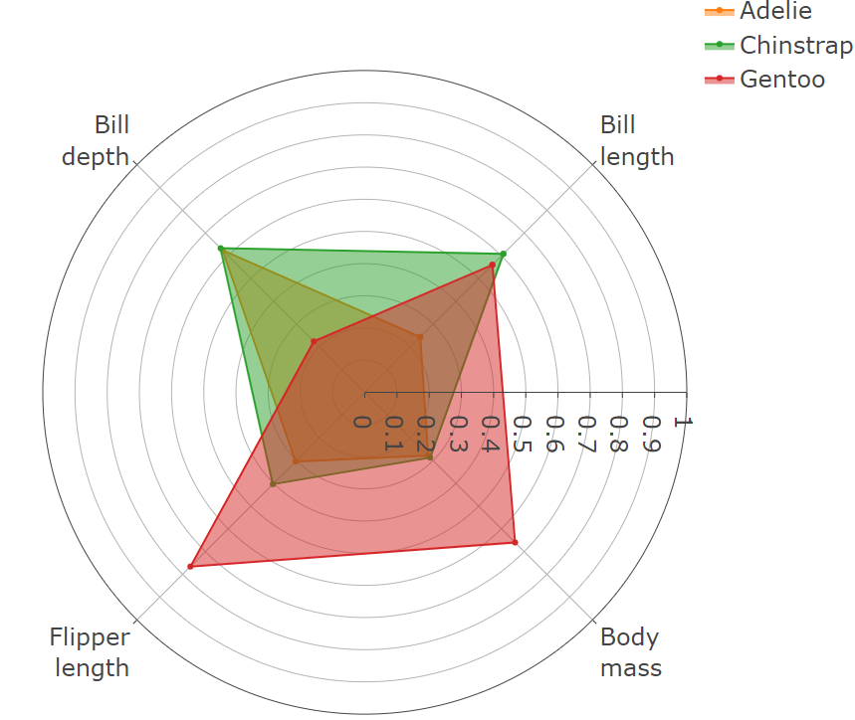
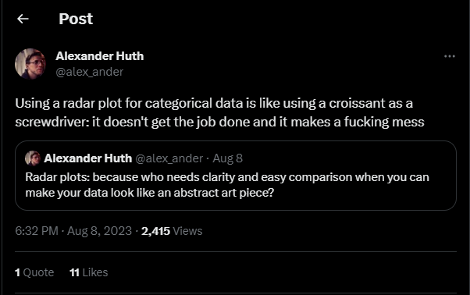
More exotic plots: radar charts
To directly compare groups based on several variables

Slide 17
Radar charts in R
library(palmerpenguins)
library(plotly)
# Start figure
fig <- plot_ly(
type = "scatterpolar", # radar chart
mode = "lines+markers", # plot points and lines
fill = "toself“ # fill with colour
)
fig <- fig %>% add_trace(
r = c(species_values, species_values[[1]]),
theta = c(attributes, attributes[1]),
name = all_species[[i]]
)
fig %>%
layout(
polar = list(
radialaxis = list(range = c(0, 1)),
angularaxis = list(rotation = 45)
))
Argument | Description
r | Tick values
theta | Tick names/angles
name | Name of subplot/plot
angularaxis | In layout: angular parameters (e.g, to rotate the plot)
radialaxis | In layout: radial parameters (e.g, to rotate the plot)

Slide 18
Full example
fig <- plot_ly(
type = "scatterpolar", # radar chart
mode = "lines+markers", # plot points & lines
fill = "toself“ # fill with colour
)
all_species <- mean_values$species
for (i in 1:length(all_species)) {
species_values <- as.character(
mean_values %>%
filter(species == all_species[[i]]) %>%
column_to_rownames("species")
)
# Add a radar plot trace fig <- fig %>% add_trace(
r = c(species_values, species_values[[1]]),
theta = c(attributes, attributes[1]),
name = all_species[[i]]
)
}
fig %>% layout(
polar = list(
radialaxis = list(range = c(0, 1)),
angularaxis = list(rotation = 45)
),
font = list(size = 16))
library(palmerpenguins)
library(plotly)
library(scales)
attributes <- c("bill_length_mm", "bill_depth_mm", "flipper_length_mm", "body_mass_g")
# Min-max normalisation
penguins_norm <- penguins %>% mutate(across(all_of(attributes), rescale))
# Mean by species
mean_values <- penguins_norm %>% summarise(
across(c(attributes), mean, na.rm = TRUE)
)

Slide 19
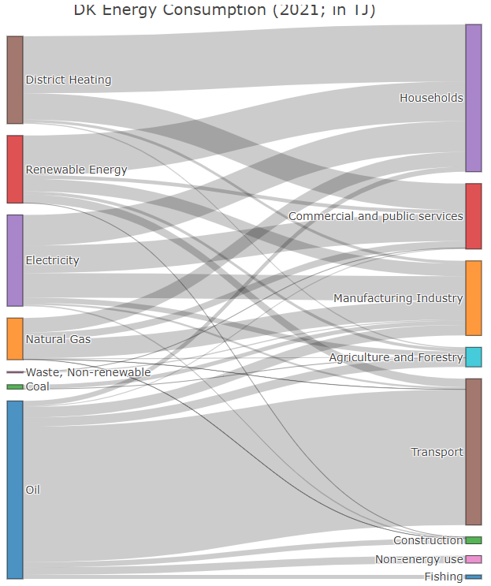
More exotic plots: Sankey plots
To depict flows from a set of values to another

Slide 20
More exotic plots: Sankey plots
fig <- plot_ly(
type = "sankey",
orientation = "h",
node = list(
label = c("Alice's expense (in $)", "Bob's expense (in $)", "How much Alice ate", "How much Bob ate", "Cheese platter", "Wine"),
pad = 15,
thickness = 20,
line = list(
color = "black",
width = 0.5
)
),
link = list(
source = c(0, 1, 0, 2, 3, 3),
target = c(2, 3, 3, 4, 4, 5),
value = c(8, 4, 2, 8, 4, 2)
)
)
Argument | Description | Example
orientation | Vertical or horizontal flow
node | List of nodes | list( label = c(“A”, “B”, C”), thickness = 20, pad = 15 )
link | List of links between nodes | list( source = source_nodes, target = target_nodes, value = link_values )

Slide 21
Hard-but-not-too-difficult-hopefully level: web apps! install.packages(“shiny”)
Maybe a bit less approachable than ggplot2 and plotly, but excellent for interactive storytelling
https://shiny.posit.co/r/gallery/life-sciences/covid19-tracker/

Slide 22
Hard-but-not-too-difficult-hopefully level: web apps! install.packages(“shiny”)
Shiny scripts (or apps) require three components:
Frontend: a user interface object ui
Backend: A server function server <- function(input, output)
input: the input required from the user
output: the output plot
A linker to create the app: shinyApp(ui = ui, server = server)

Slide 23






Frontend and backend
Frontend = presentation layer
Common focuses:
User Interface (UI)
Accessibility
Web performance
Web design
Backend = data access layer
Common focuses:
Algorithms, core logic of the application
Data management, engineering, analysis
Security

Slide 24


Slide 25
Example: A histogram with varying number of bins
# Define UI for app that draws a histogram
ui <- fluidPage( # App title
titlePanel("Hello Shiny!"),
# Sidebar layout with input and output definitions
sidebarLayout( # Sidebar panel for inputs ----
sidebarPanel( # Input: Slider for the number of bins
sliderInput(
inputId = "bins", label = "Number of bins:",
min = 1, max = 50, value = 30
)
),
# Main panel for displaying outputs
mainPanel( # Output: Histogram
plotOutput(outputId = "distPlot")
)
)
)
User interface:

Slide 26
Example: A histogram with varying number of bins
# Define server logic required to draw a histogram ----
server <- function(input, output) {
# Histogram of the penguins’ body masses
# with requested number of bins
# 1. Process data
penguins <- na.omit(penguins)
# 2. Wrap the plot in renderPlot to
# - It is "reactive" and therefore should be automatically
# re-executed when inputs (input$bins) change
# - Its output type is a plot
output$distPlot <- renderPlot({
ggplot(penguins, aes(x = body_mass_g)) +
geom_histogram(bins = input$bins) +
labs(
x = "Body mass(g)",
main = "Body mass of Palmer Penguins"
)
})
}
Server

Slide 27
Example: A histogram with varying number of bins
User interface:
Server:
# Define UI for app that draws a histogram
ui <- fluidPage( # App title
titlePanel("Hello Shiny!"),
# Sidebar layout with input and output definitions
sidebarLayout( # Sidebar panel for inputs ----
sidebarPanel( # Input: Slider for the number of bins
sliderInput(
inputId = "bins",
label = "Number of bins:",
min = 1, max = 50, value = 30
)
),
# Main panel for displaying outputs
mainPanel( # Output: Histogram
plotOutput(outputId = "distPlot")
)
)
)
# Define server logic required to draw a histogram ----
server <- function(input, output) {
# Histogram of the penguins’ body masses
# with requested number of bins
# 1. Process data
penguins <- na.omit(penguins)
# 2. Wrap the plot in renderPlot to
# - It is "reactive" and therefore should be automatically
# re-executed when inputs (input$bins) change
# - Its output type is a plot
output$distPlot <- renderPlot({
ggplot(penguins, aes(x = body_mass_g)) +
geom_histogram(bins = input$bins) +
labs(
x = "Body mass(g)",
main = "Body mass of Palmer Penguins"
)
})
}
output =
the histogram
input =
number of bins

Slide 28
What to put in the server (backend)?
That’s the “easy” part ☺ You should put:
Everything related to data analysis
The data visualisation (using ggplot2, plotly…)

Slide 29
What to put in the server (backend)? reactivity
An expression is reactive if its result changes over time
Ex:
Input = penguin species
Output = body mass distribution
Reactivity is essential to save computation time in your Shiny apps
How it works:
Upon the first execution of the program, the result will be saved in memory
The reactive object then checks if the value is up-to-date or not:
If yes, it returns the saved value (no extra computation)
If not, it computes the new value

Slide 30
Reactivity in practice
# Make the input species reactive
s <- reactive({
input$species
})
# s is now reactive
# -> write s()
s_body_mass <- reactive({
penguins %>%
filter(species == s()) %>%
select(body_mass_g)
})
# s_body_mass is now reactive
output$distPlot <- renderPlot({
ggplot(s_body_mass(), aes(x = body_mass_g)) +
geom_histogram() +
labs(
x = "Body mass(g)",
main = "Body mass of Palmer Penguins"
)
})
To get the value of a reactive variable, you call it like a function()

Slide 31
What to put in the UI (frontend)?
The basic/easiest skeleton:
Use the fluidPage function
2 main arguments:
sidebarLayout = 3 main arguments:
ui <- fluidPage(
titlePanel("title panel"),
sidebarLayout(
position = "right",
sidebarPanel("sidebar panel"),
mainPanel("main panel")
)
)
Argument | Description
titlePanel | The title of the app
sidebarLayout | Layout with one sidebar panel and a main panel
Argument | Description
position | Where to put the sidebar panel
sidebarPanel | The content of the sidebar panel
mainPanel | The content of the main panel

Slide 32
What to put in the UI (frontend)?
Skeleton with input/output:
Add a widget to control the input in the sidebar panel:
At least 2 arguments for each widget:
ui <- fluidPage(
titlePanel("Hello Shiny!"),
sidebarLayout(
sidebarPanel(
# Slider input
sliderInput(
inputId = "bins",
label = "Number of bins:",
min = 1, max = 50, value = 30
)
),
mainPanel(“main panel")
)
)
Argument | Description
numericInput | Field to enter numbers
selectInput | A box with choices to select from
sliderInput | A slider bar
Argument | Description
inputId | The name of the input
label | The title of the widget

Slide 33
What to put in the UI (frontend)?
Skeleton with input/output:
Display a reactive output:
One main argument for plotOutput:
ui <- fluidPage(
titlePanel("Hello Shiny!"),
sidebarLayout(
sidebarPanel(
# Slider input
sliderInput(
inputId = "bins",
label = "Number of bins:",
min = 1, max = 50, value = 30
)
),
mainPanel(
# Plot output
plotOutput(outputId = "distPlot")
)
)
)
Argument | Description
dateTableOutput, tableOutput | Creates a table
plotOutput | Creates a plot
Argument | Description
outputId | The name of the output plot

Slide 34
Bonus: animations install.packages(“gganimate”)
Key point here is “transition_time” to set how the points will change from one frame to another
library(gganimate)
library(gapminder)
rstat <- ggplot(
gapminder,
aes(x = gdpPercap, y = lifeExp,
size = pop, colour = country
)
) +
geom_point(show.legend = FALSE, alpha = 0.7) +
scale_color_viridis_d() +
scale_size(range = c(2, 12)) +
scale_x_log10() +
labs(x = "GDP per capita", y = "Life expectancy")
ranim <- rstat +
transition_time(year) +
labs(title = "Year: {frame_time}")
animate(ranim)

Slide 35
Helper function for networks: get_edge_shapes
get_edge_shapes <- function(edges, Xn, Yn, color = "k", width = 0.3) {
# Get a list of edges with their shapes
# shape is a line with a specific color, width
# and x0/y0 (vertex 0) x1/y1 (vertex 1)
# Get number of rows
Ne <- nrow(edges)
edge_shapes <- list()
for(i in 1:Ne) {
# Find vertices
v0 <- edges[i,]$V1
v1 <- edges[i,]$V2
edge_shape = list(
type = "line",
line = list(color = color, width = 0.3),
# X and y position of v0
x0 = Xn[v0],
y0 = Yn[v0],
# X and y position of v1
x1 = Xn[v1],
y1 = Yn[v1]
)
# Add to edge_shapes
edge_shapes[[i]] <- edge_shape
}
# Return
edge_shapes
}

